Slide 1


Envoy
Nikola Velikov, Bozhidar Ivanov

Slide 2

Repository link
https://github.com/sebivenlo/ esd-2024-envoy

Slide 3
Table of contents
1.Microservices & Networking
2.Proxies & Load Balancing
3.Envoy-Specific Concepts
4.Security
5. Configuration & Deployment
6. Performance & Optimization

Slide 4
Microservices architecture
Advantages
Disadvantages

Slide 5
Microservices communication

Slide 6
Service discovery

Slide 7
Service-to-service authentication

Slide 8
Proxies & Load Balancing

Slide 9
Types of proxies & Envoy

Slide 10
Key functions of a Layer 7 proxy

Slide 11
Envoy’s load balancing

Slide 12
Comparison between proxies - Envoy

Slide 13
Envoy-Specific Concepts

Slide 14

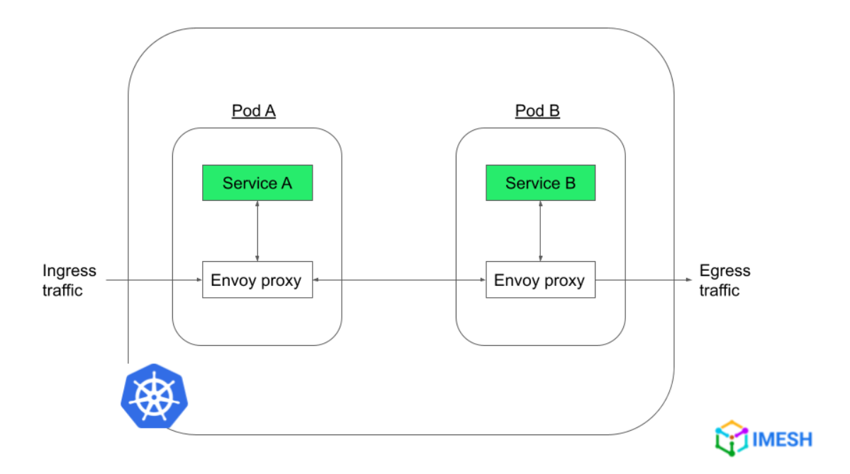
Issue that Envoy resolves and purpose
Handle the complex networking challenges of modern microservice-based architectures
Serves the purpose of a communication bus for microservices across the cloud, to communicate with each other in a rapid, secure, and efficient manner

Slide 15
Envoy’s traffic routing between services
1. Version upgrades: traffic to a route is shifted gradually from one cluster to another
2. Multivariate testing: two or more version of the same service are tested simultaneously. The traffic to the route must be split between clusters running different versions of the same service.
Notes:
Explanation of each one of them with the pictures and concept explanation

Slide 16
Envoy’s handling of resilience features
Circuit Breaking
Retires
Retries in gRPC services
Outlier Detection

Slide 17
Envoy’s observability
Metrics
Logging
Traces

Slide 18

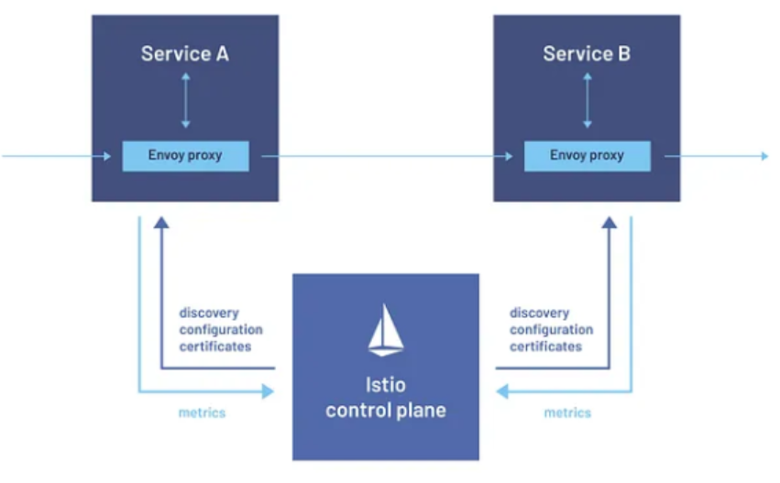

Envoy’s role in a service mesh
Ensure reliable and fast communication between services
Have high observability on requests through these service.
In case of issues, being quickly able see what is failing and where
Easily configure and change request routes.
Have resilient communication practices in place, like circuit breaker , retry mechanism etc.

Slide 19


Communicational protocols that Envoy supports

Slide 20
Security

Slide 21
Security implications of using a reverse proxy

Slide 22
Envoy’s handling of TLS and mTLS terminations
TLS termination
Mutual TLS termination (mLTS)

Slide 23
Authentication and Authorization policies
Authentication:
JWT Authentication
mTLS Authentcation
Authorization:
RBAC (Role-Based Access Control)
External Authorization
Why should you use Envoy for Authentication and Authorization?

Slide 24
Configuration & Deployment

Slide 25
How is typically Envoy deployed?

Slide 26
Envoy’s config file structure

Slide 27
Dynamic configuration and control plane interaction in Envoy

Slide 28
Envoy’s integration with orchestration system like Kubernetes

Slide 29
Performance & Optimization

Slide 30
Performance considerations when using Envoy in a high-traffic environment

Slide 31
Comparison between Envoy’s performance and other reverse proxies in terms of latency and throughput

Slide 32
QUIZZZZ time

Slide 33



Slide 34


